Slide 1

TANGO-Grafana: an online diagnostic tool to assist in the analysis of interconnected problems difficult to debug in the context of the Square Kilometre Array (SKA) telescope project
Matteo Di Carlo (INAF-OAAB)
M. Di Carlo, P. Harding, G. Le Roux, M. Dolci

Slide 2






SKAMPI
Many different active components coordinating each other with the help of the TANGO-controls framework
The🌍 SKA MVP Prototype Integration (SKAMPI): set of software artefacts, the corresponding repository and continuous integration facilities for the development, testing, and integration of the SKA prototype software systems
Tango-controls

Slide 3
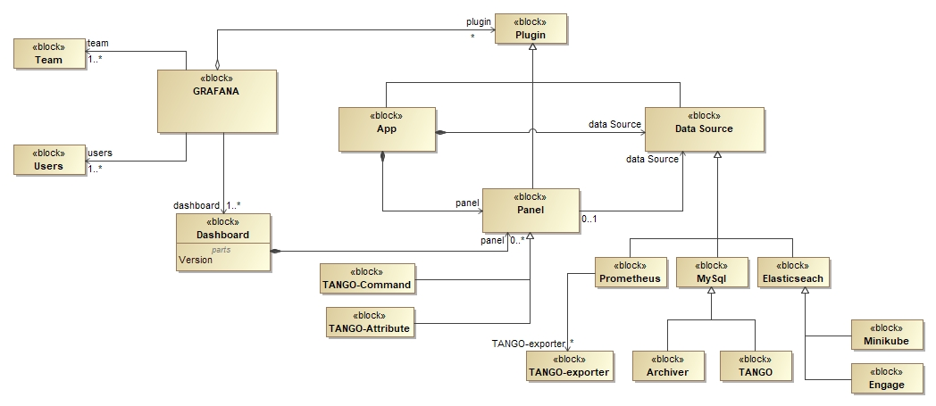
TANGO-Grafana: PROMETHEUS + GRAFANA + TANGO-controls

Slide 4
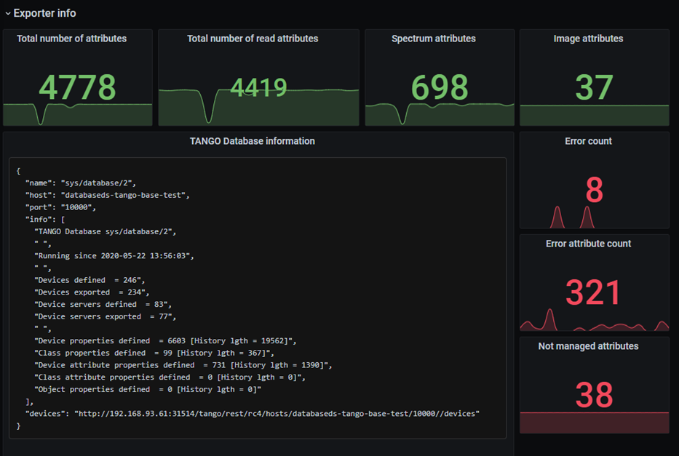
Example 1

Slide 5
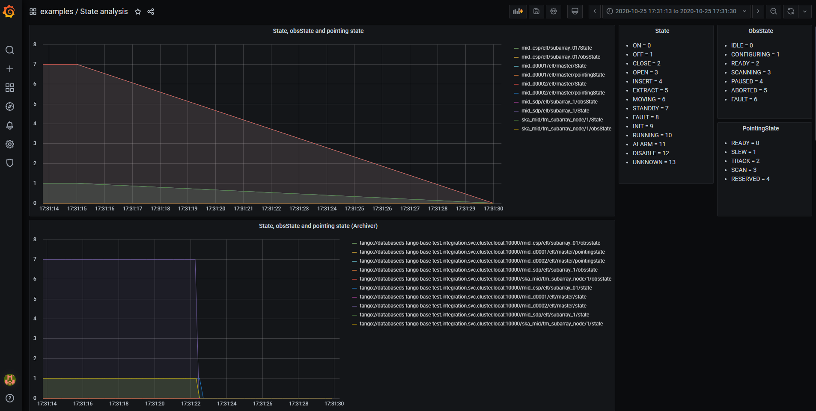
Example 2

Slide 6
Thanks

